Slide 1
Discrete Mathematics BCSC0010
Module 1
Probability

Slide 2
Problems
Coins
Dice
Cards
Bags and balls

Slide 3
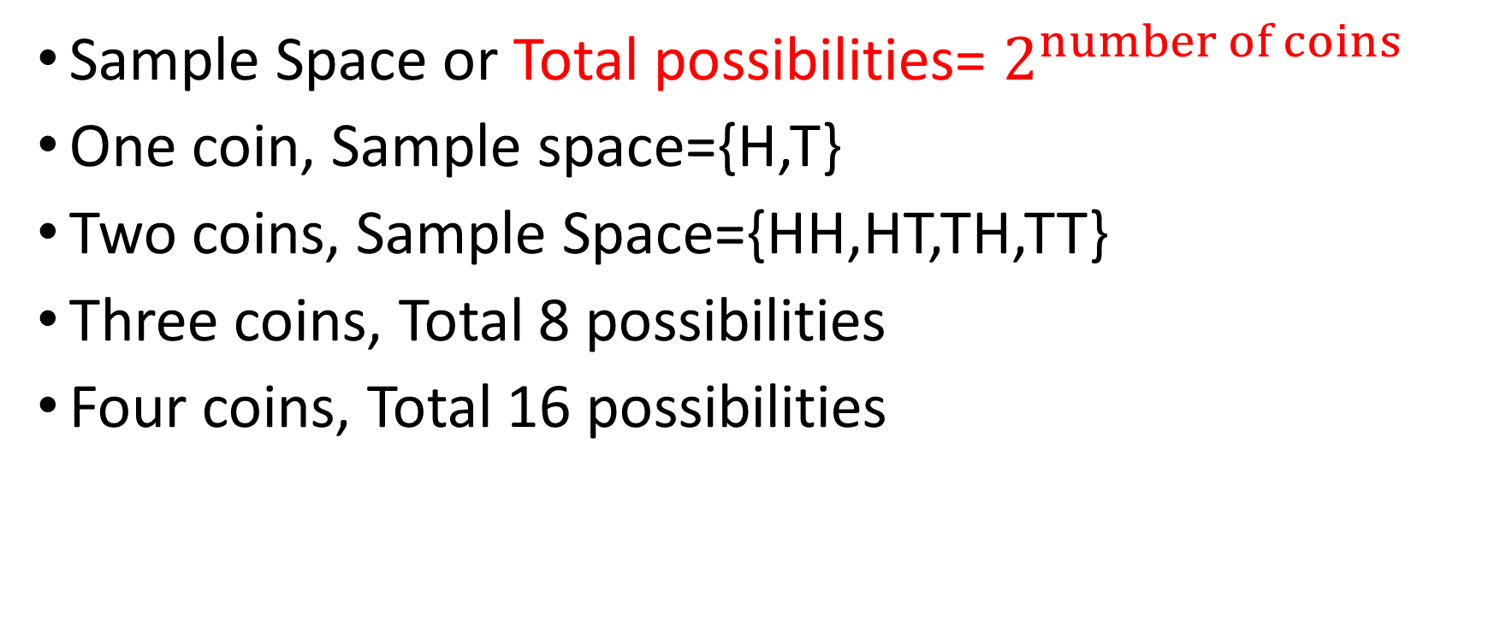
Coins
Sample Space or Total possibilities= $2^{number of coins}$
One coin, Sample space={H,T}
Two coins, Sample Space={HH,HT,TH,TT}
Three coins, Total 8 possibilities
Four coins, Total 16 possibilities

Slide 4
Example (2 coins)
In a simultaneous toss of 2 coins, find the probability of 2 tails.
{HH,HT,TH,TT}
n(S)=4
n(A)=1
P(A) = n(A)/n(S)
P=1/4

Slide 5
Example (3 coins)
Find the probability of all heads
n(S)=8
n(A)=1
P(A) = n(A)/n(S)
P=1/8
Find the probability of exactly 2 heads
P=3/8

Slide 6
Example (4 coins)
Exactly 3 tails
P=4/16
At least one tail
P=15/16

Slide 7
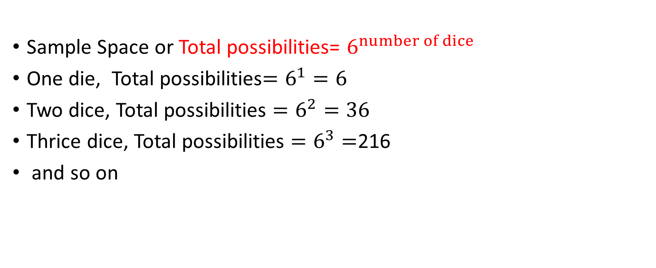
Dice
Sample Space or Total possibilities= $6^{number of dice}$
One die, Total possibilities$=6^{1}=6$
Two dice, Total possibilities $=6^{2}=36$
Thrice dice, Total possibilities $=6^{3}=$216
and so on

Slide 8
If one dice is thrown. What is the probability that it shows prime number?
P =3/6
=1/2

Slide 9
In a single throw of 2 dice, find probability of getting
A doublet (both show same number)
P=6/36
A total of 11
P=2/36
Both face show even number
P=(3x3)/36
=1/4

Slide 10
In a single throw of 3 dice, find probability of getting
Sum of faces is 16
6,6,4 => (permutation with repetition) 3 ways
6,5,5 => 3 ways
P=(3+3)/216
Sum on face is 15
3,6,6 => 3 permutations
6,5,4 => 6 permutations
5,5,5 => 1 permutations
P=(3+6+1)/216

Slide 11
Cards
Basic Terminology and information
Total cards: 52
Colors: Red (26) and Black (26)
Shapes: clubs (♣), diamonds (♦), hearts (♥) and spades (♠)
13 cards of each shape (2 to 10 , Ace, Jack, King, Queen)
Each number → 4 in total (eg. 4 Ace in 52)
Face cards : 16

Slide 12
Examples (Cards)
One card is drawn at random from 52 cards. What is the probability of picking a black card?
P=26/52=1/2
Picking an Ace of spades or Jack of Diamonds
P=(1+1)/52=1/26

Slide 13
Examples (Cards)
What is the probability of both are red, if :
2 cards drawn one by one.
P=(26/52)x (25/51)
= 25/102
If 2 cards drawn at random.
P=C(26,2)/C(52,2)

Slide 14
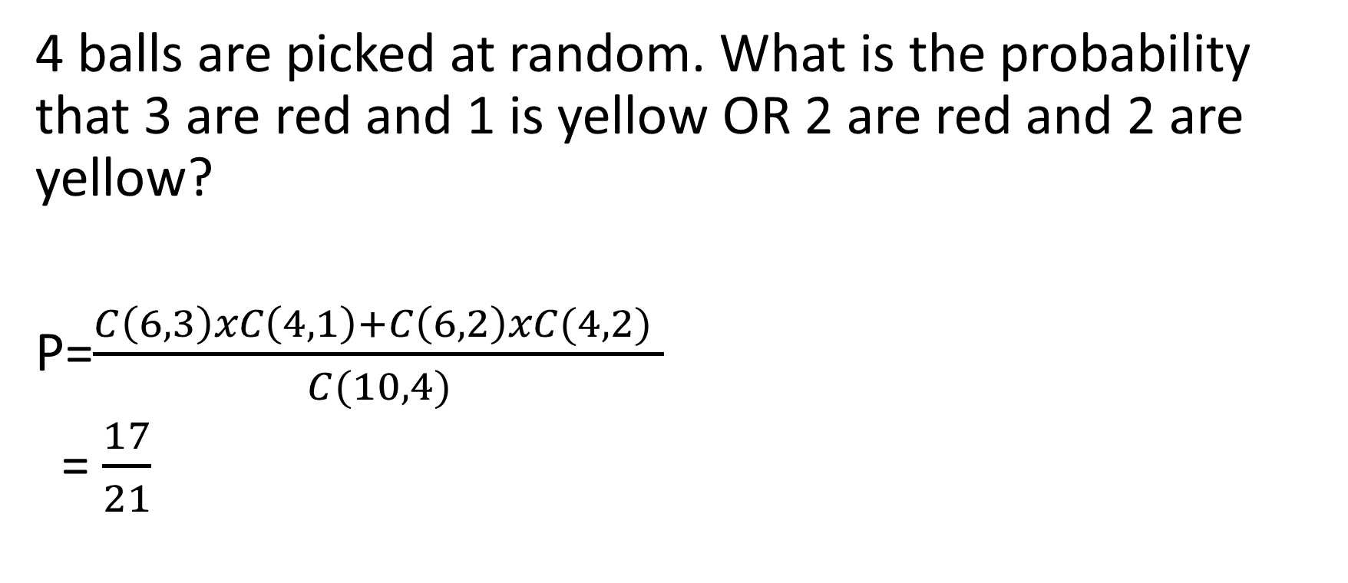
1 Bag and 2 color balls A bag contains 6 red balls and 4 yellow balls
4 balls are picked at random. What is the probability that 3 are red and 1 is yellow OR 2 are red and 2 are yellow?
P=$\frac{C\left(6,3\right)xC\left(4,1\right)+C\left(6,2\right)xC(4,2) }{C(10,4)}$
= $\frac{17}{21}$

Slide 15
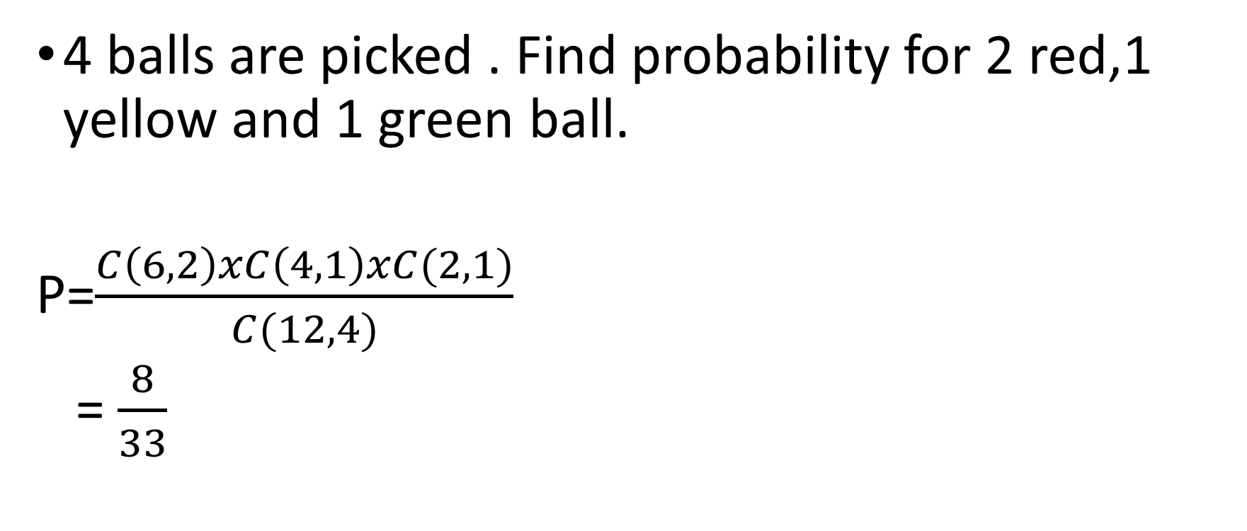
1 Bag and 3 color balls A bag contains 6 red , 4 yellow and 2 green balls
4 balls are picked . Find probability for 2 red,1 yellow and 1 green ball.
P=$\frac{C\left(6,2\right)xC\left(4,1\right)xC(2,1)}{C(12,4)}$
= $\frac{8}{33}$

